Slide 1
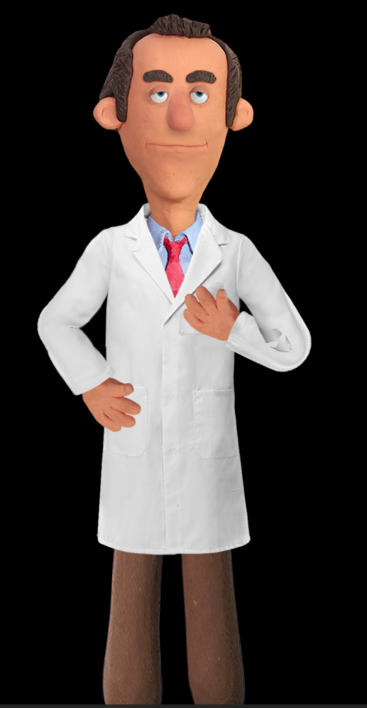
“How did they do that …
Kelvin Cording
July 2018

Slide 2
Adobe - Character Animator CC
Part of the Adobe Creative Cloud
Key Features
Rig Puppets
Record - Action and Sound From Camera and Microphone (internal or external)
Stream Video on line using OBS (Open Broadcaster Software)

Slide 3
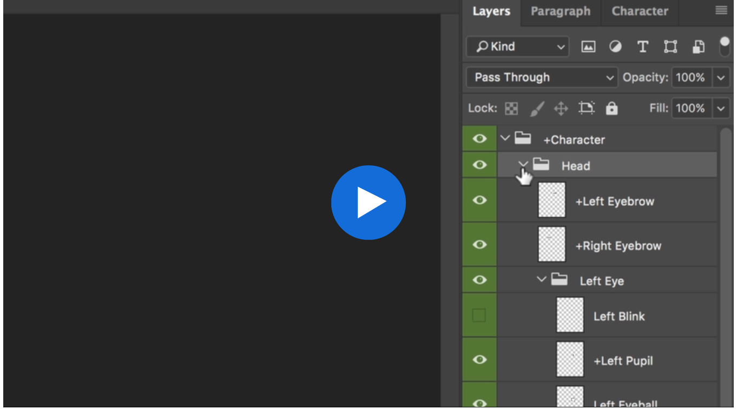
Puppets - Creation and Rigging
Created in Photoshop or Illustrator
Create layers for each part

Slide 4
Example of Rigging
To run video place curser on picture

Slide 5
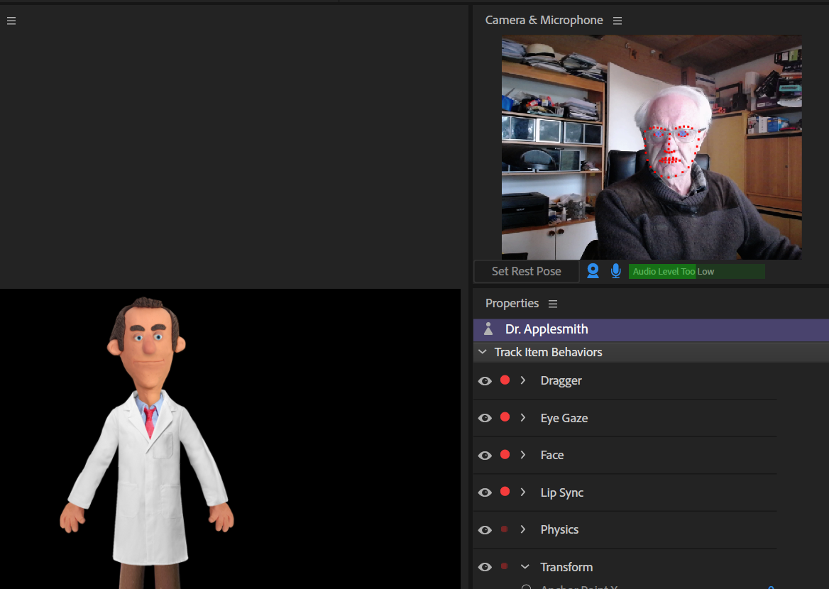
Capturing Sound and Movement

Slide 6
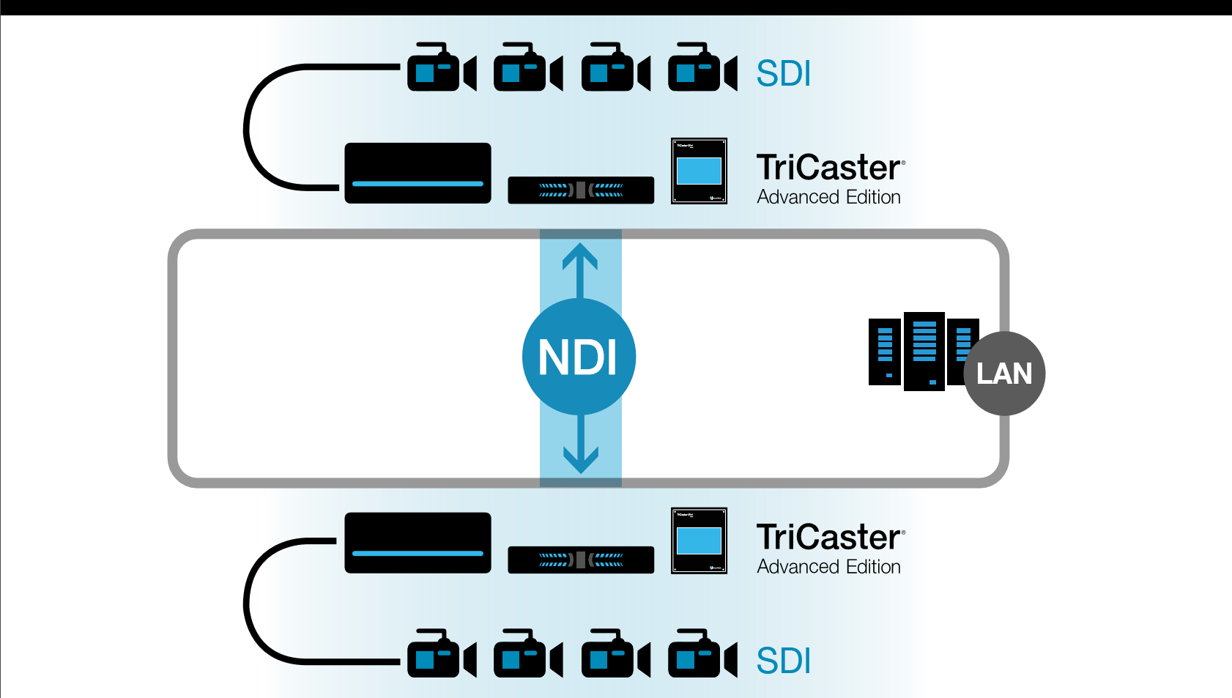
Network Device Interface

Slide 7
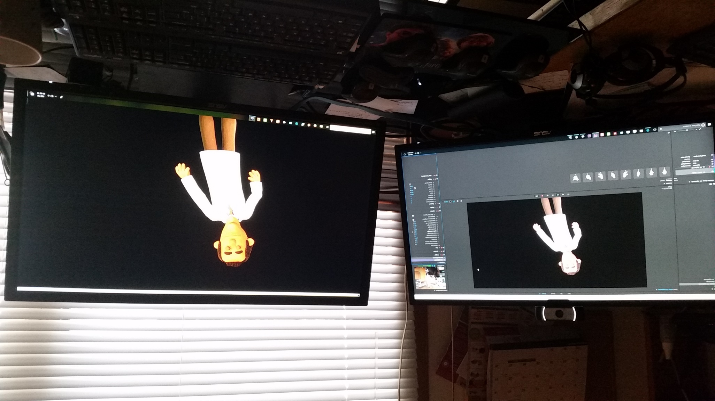
Using NDI to connect to another computer on LAN Network

Slide 8
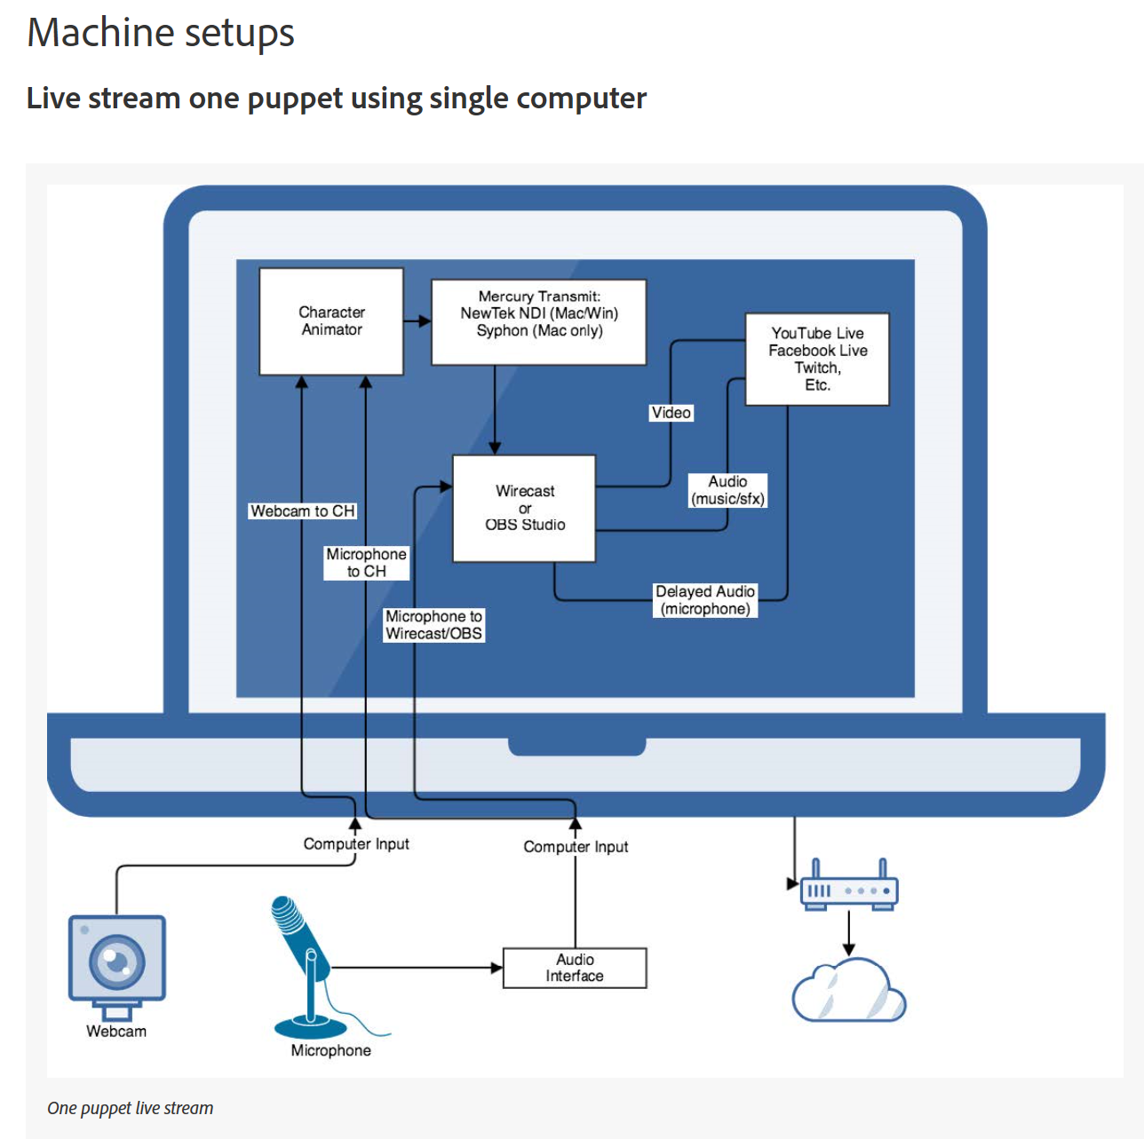

Slide 9
Questions ????

