Slide 1
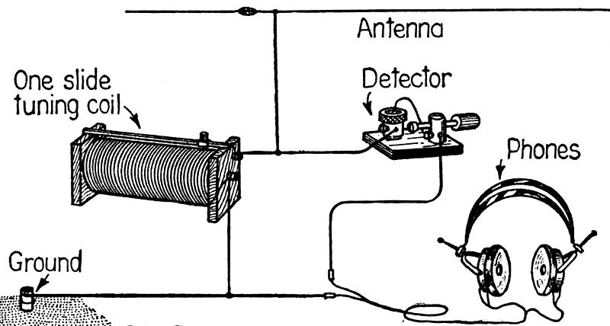
Crystal Sets?

Slide 2
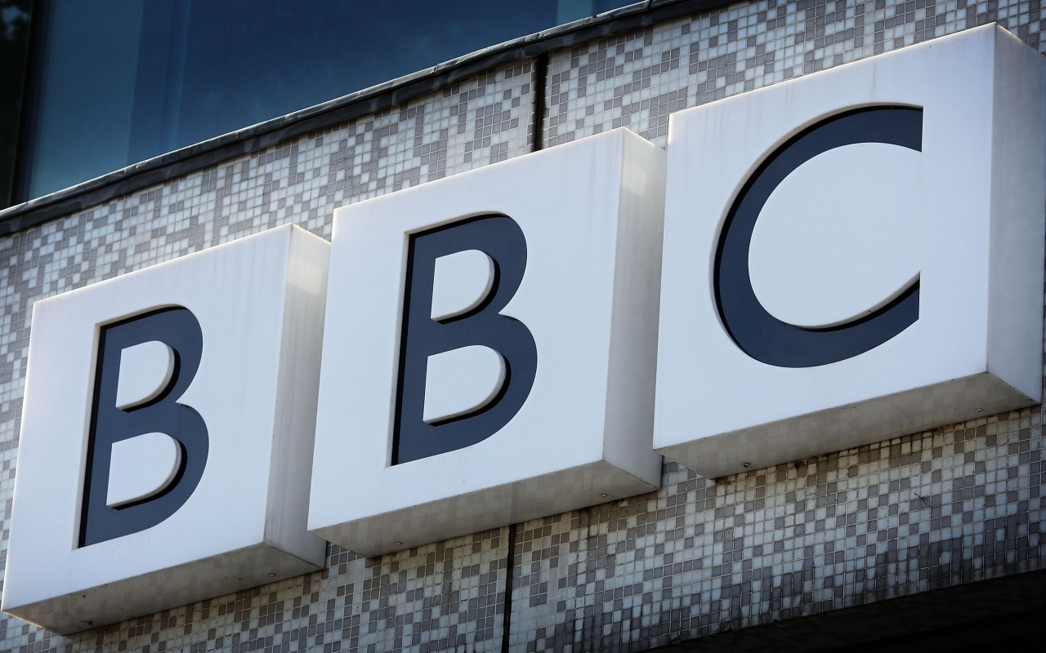
Live Streaming
Multimedia 6/04/18
David King

Slide 3
British Broadcasting Corporation
World’s Oldest National Broadcasting Organisation (Established: 1 January 1927).
Commenced TV Transmissions in 1930.
World’s Largest Broadcaster: 35,000 staff.
Funded by an Annual TV Licence Fee and Sale of Programs (25%).
Revenue‎: ‎£4.954 billion (2016/17).

Slide 4
BBC Reception Permissions
Television - UK Residents with TV Licence
Licence: £144.50 per Annum,
No Licence: Fine £1000 plus Costs,
Bypass: Register using UK Address,
Generic Email Address and VPN?
Radio – Anybody, Any Time.
Free (No limitations).
BBC App.
BBC Website (http://www.bbc.co.uk/radio).

Slide 5
Microsoft Store -Windows 10

Slide 6
National-Radio Stations

Slide 7
Nations & Local Radio

Slide 8
Local Radio (continued)

Slide 9
National – FM, DAB and Online.
Radio | Description
 | BBC Radio 1 97-99 FM Current hit music, dance and rock.Slogan = Where it begins – BBC Radio 1 where the UK’s journey into new music begins, from pop to dance, from hip hop to rock and everything in between
 | BBC Radio 2 88-91 FM Adult contemporary, oldies, country, jazz, soul and funk. Slogan = The home of great music – Pop and Rock from the fifties, sixties, seventies, eighties and beyond to blues, big band, country and jazz with the best live music and documentaries
 | BBC Radio 3 90-93 FM Classical, jazz, world music, arts, culture and drama. Slogan = Radio 3 broadcasts classical music, jazz, world music, new music, arts programmes and drama. It's the home of the Proms and broadcasts more live music than any other network
 | BBC Radio 4 92-95 FM Spoken-word programming, drama and philosophy. Slogan = Intelligent speech, the most insightful journalism, the wittiest comedy, the most fascinating features and the most compelling drama and readings anywhere in UK radio

Slide 10
National – AM, DAB and Online.
Radio | Format
 | BBC Radio 5 Live News, current affairs, discussion and sport. Slogan = Live news and live sport. Premier League football, Champions League football, Europa League football, international football, FA Cup football, Championship Football, Football League, Scottish...'
 | BBC Radio Asian Network station for the British-Asian community. Slogan = BBC Asian Network – Bollywood, Bhangra, Asian Urban and underground. Home of Desi music, news and documentaries

Slide 11
National - DAB and Online.

Slide 12
My Favourite: BBC Station “Comedy, Drama & Entertainment”

Slide 13
http://www.bbc.co.uk/radio

Slide 14
“On The Phone”

Slide 15
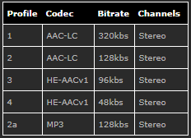
Data Usage: 8 March-5 April 2018
Total: 16,252 MB (16.25 GB)
BBC iPlayer Radio: 16,252 MB (16.25 GB)

Slide 16
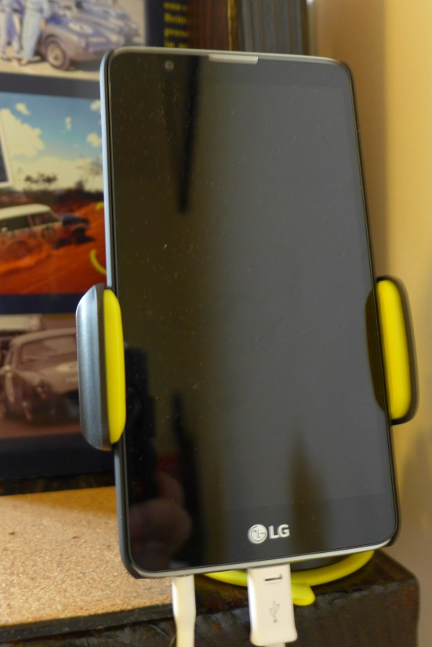
Listening in Bed
LG DAB+ Stylus

Slide 17
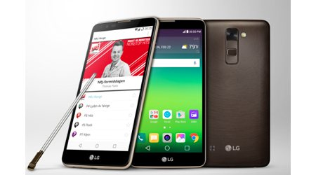
LG Stylus DAB+ Smart Phone
LG Stylus DAB+ sports a stylus for note taking and built-in DAB+ for data-free radio reception.

Slide 18
Questions/Comments?

